Slide 1

Team Members
Daksh Rawat
Avni Mitawalkar
Nikita Jarile
Sanket Koli
Manoj Yathindra Thagadurs
Sen Wang
Divya Kotapati

Slide 2
List of Documents
BRM Diagram; User Role
Context Diagram; System Interface Table
Architecture Diagram; (Logical and Process view)
RCT (Functional Decomposition, Supplementary Requirements)
Use Case Diagrams (UML)
Activity Diagram (UML)
Data-flow Diagrams (Logical and Physical)
Functional Requirements (User Stories)
ER Diagram (Conceptual, and Logical)
Source code sample (part of Demo) + GitHub repository slides (Images) Test Plan Document Application Demo

Slide 3
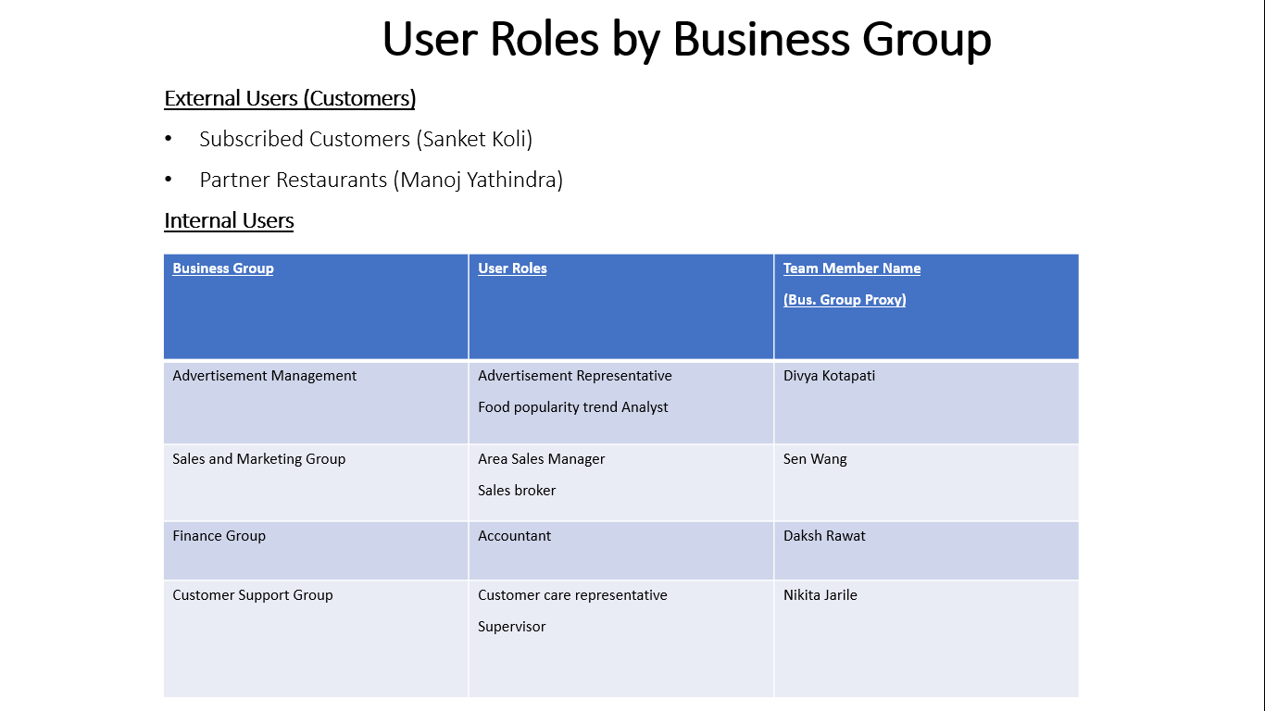
BRM Diagram; User Role (Presenter:- Avni Mitawalkar)

Slide 4
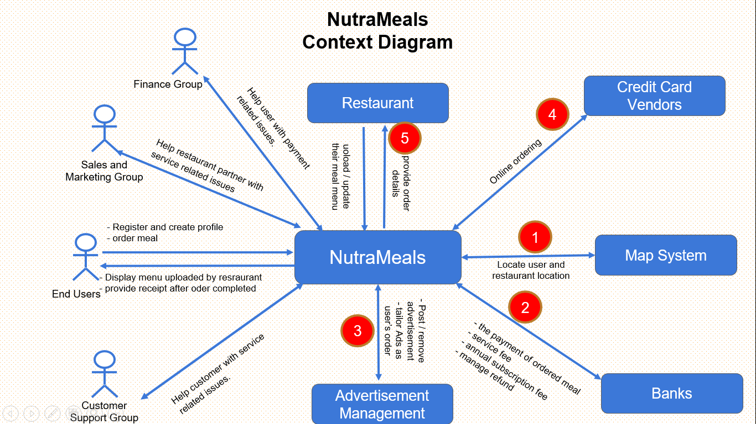
Context Diagram (Presenter:- Sen Wang)

Slide 5
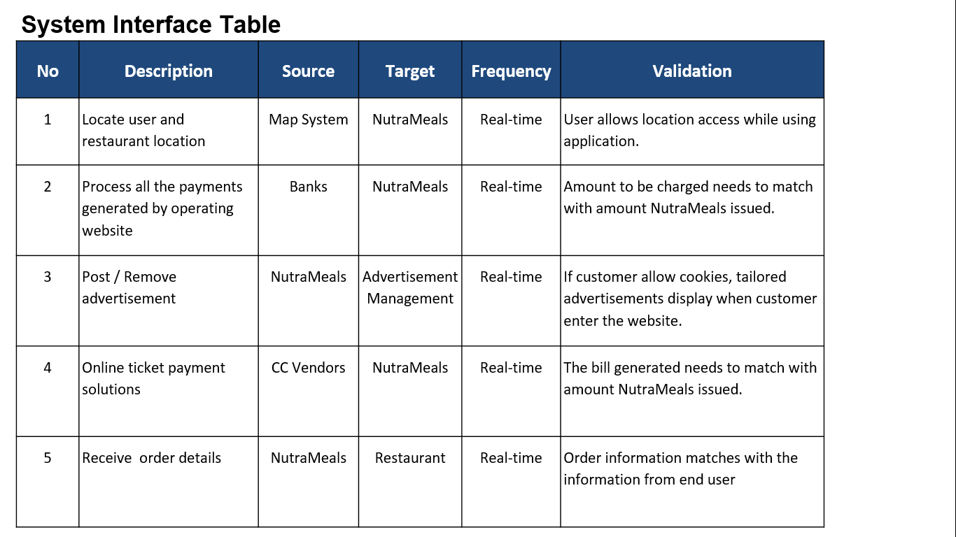
Context Diagram; System Interface Table (Presenter:- Sen Wang)

Slide 6
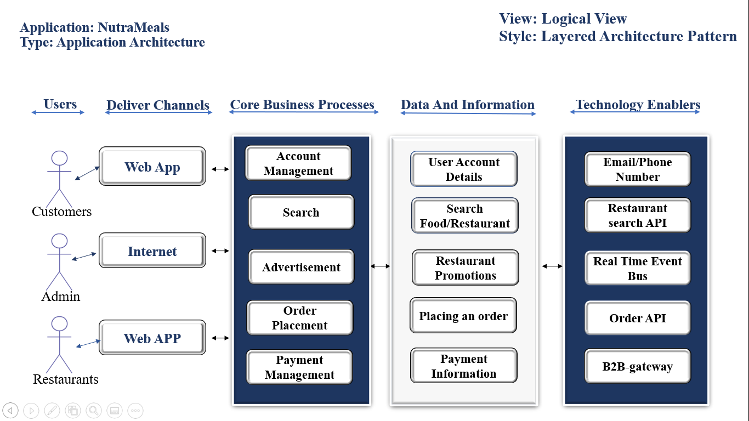
Architecture Diagram; (Logical View) (Presenter:- Nikita Jarile)

Slide 7
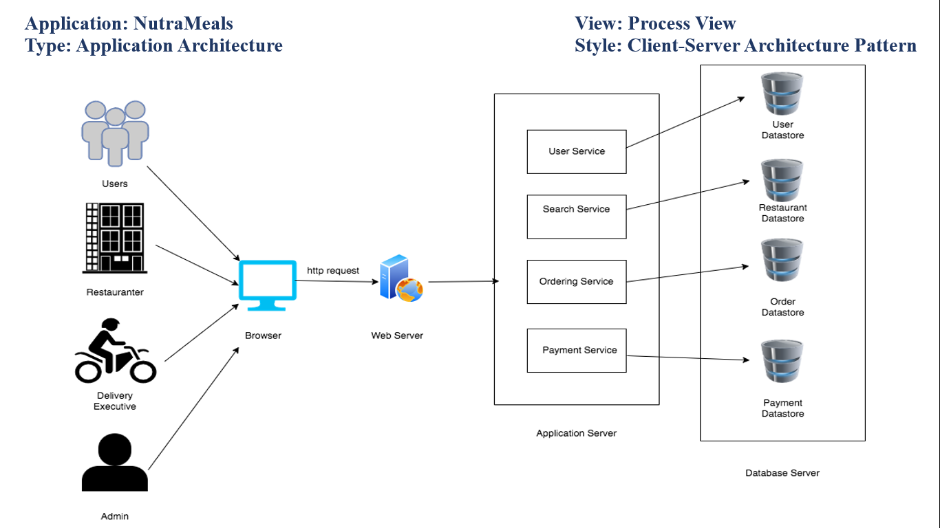
Architecture Diagram; (Process view) (Presenter:- Nikita Jarile)

Slide 8
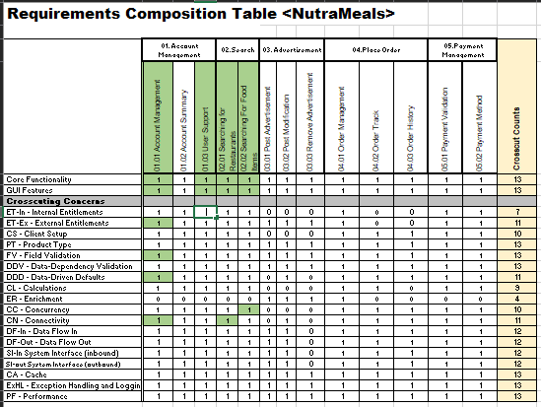
RCT (Functional Decomposition) (Presenter:- Avni Mitawalkar)

Slide 9
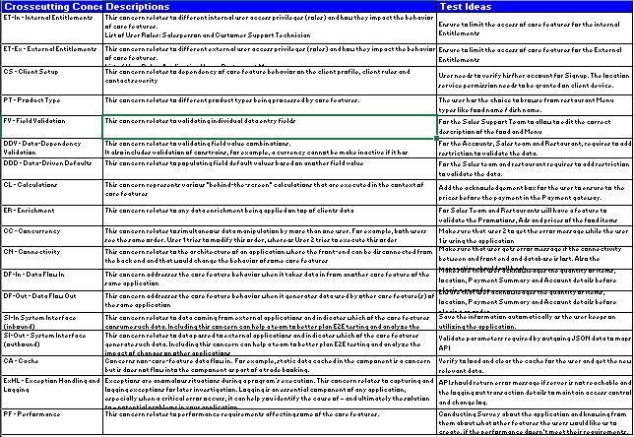
RCT (Supplementary Requirements) (Presenter:- Avni Mitawalkar)

Slide 10
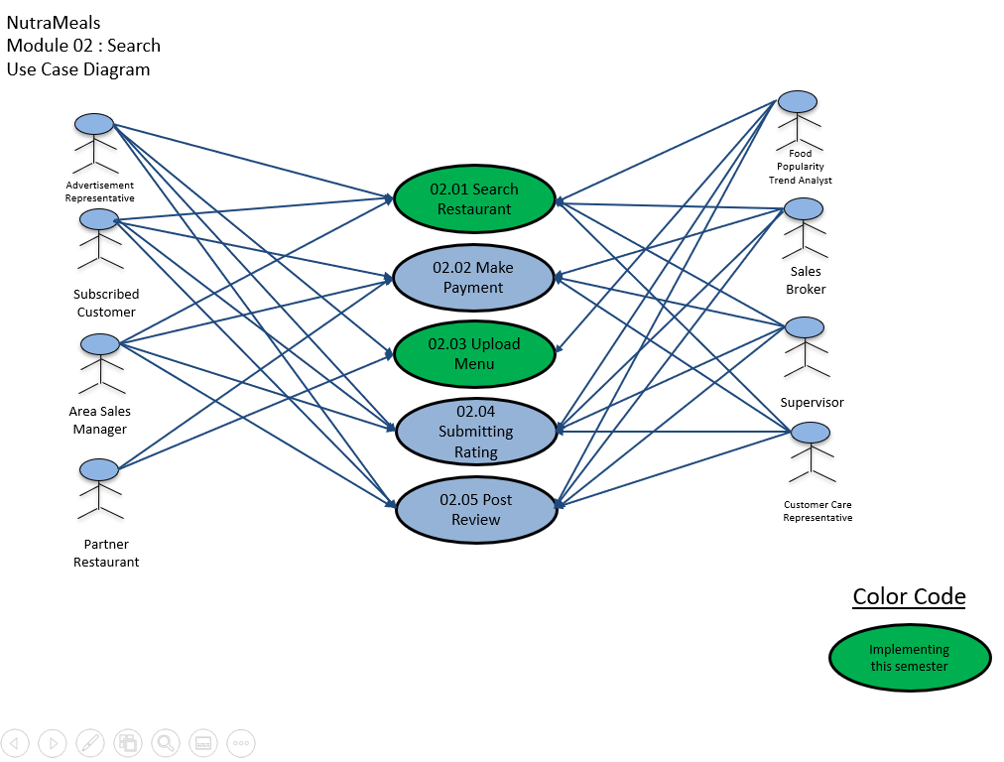
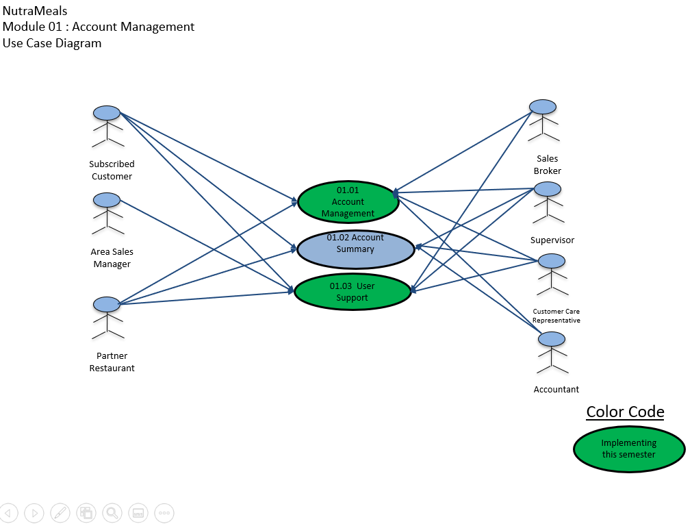
Use Case Diagrams (UML) (Presenter:- Sen Wang)

Slide 11
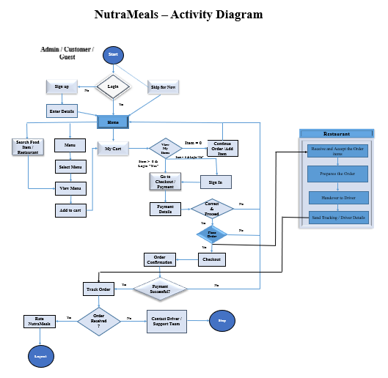
Activity Diagram (UML) (Presenter:- Divya Kotapati)

Slide 12
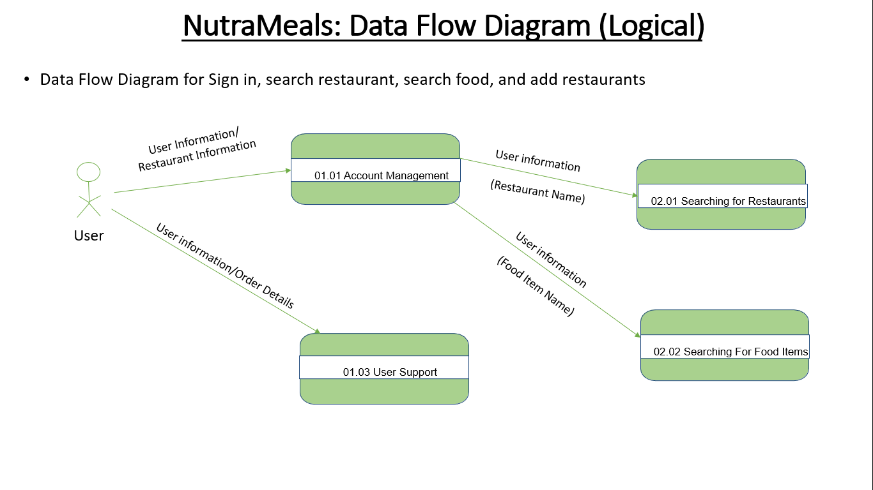
Data-flow Diagrams (Logical) (Presenter:- Daksh Rawat)

Slide 13
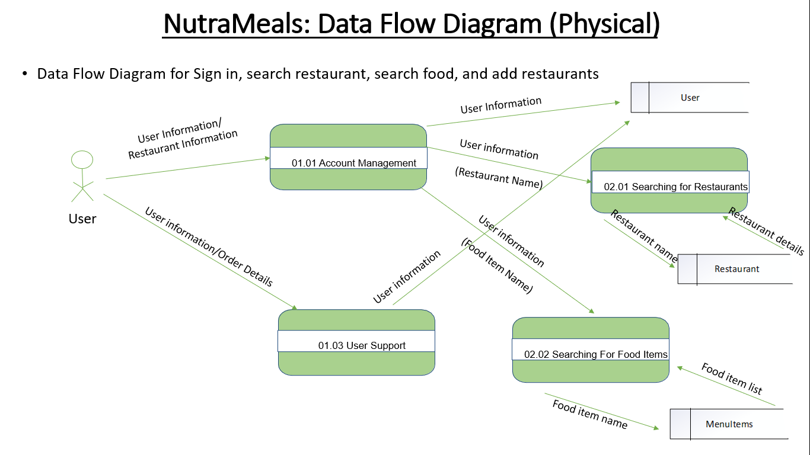
Data-flow Diagrams (Physical) (Presenter:- Daksh Rawat)

Slide 14
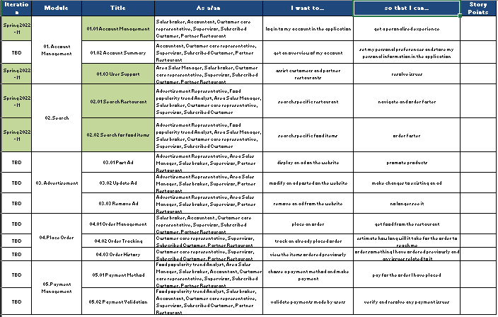
Functional Requirements (User Stories) (Presenter:- Sanket Koli)

Slide 15
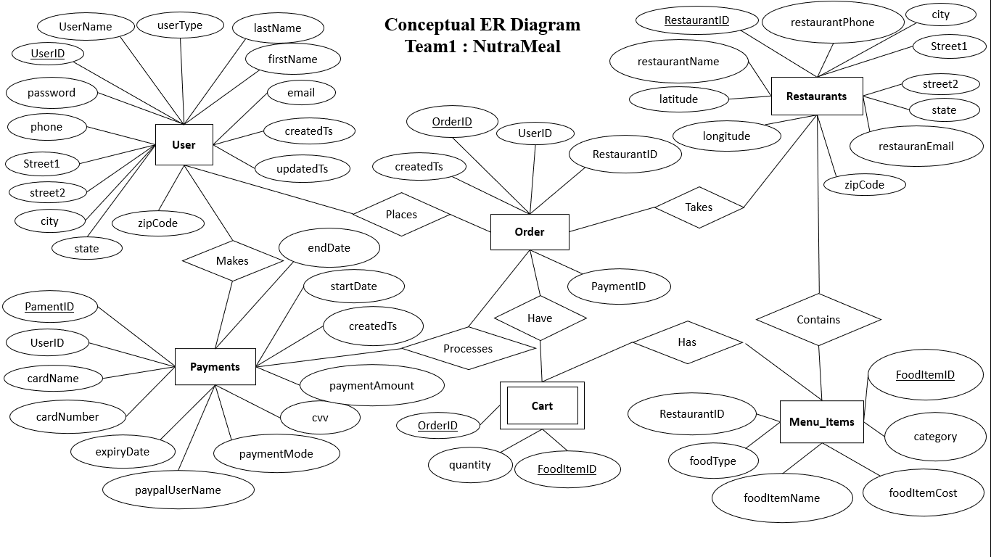
ER Diagram (Conceptual) (Presenter:- Manoj Yathindra Thagadurs)

Slide 16
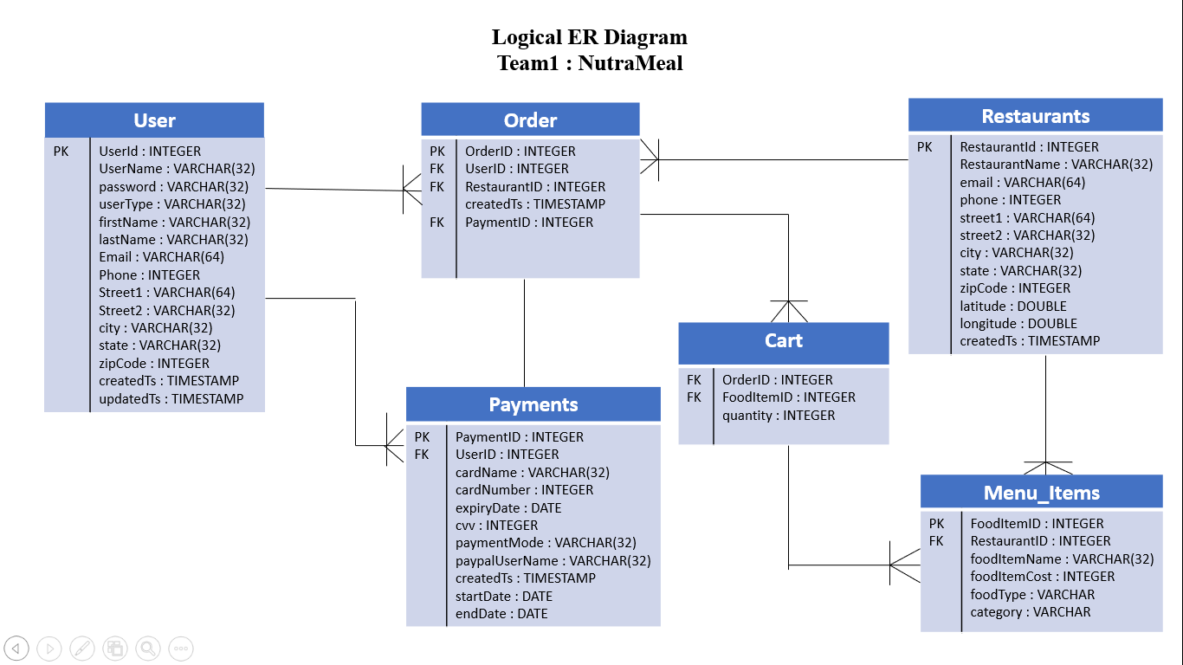
ER Diagram (Logical) (Presenter:- Manoj Yathindra Thagadurs)

Slide 17
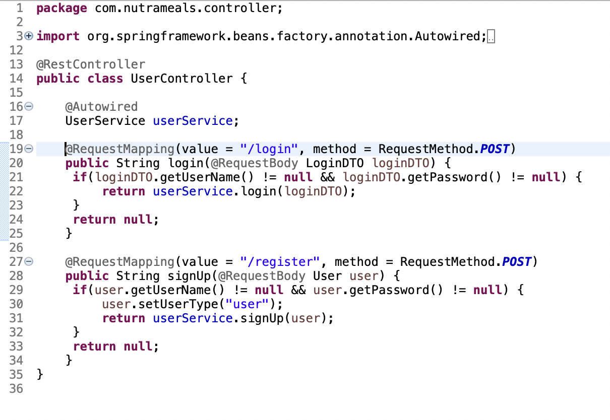
Source code sample (Presenter:- Nikita Jarile)

Slide 18
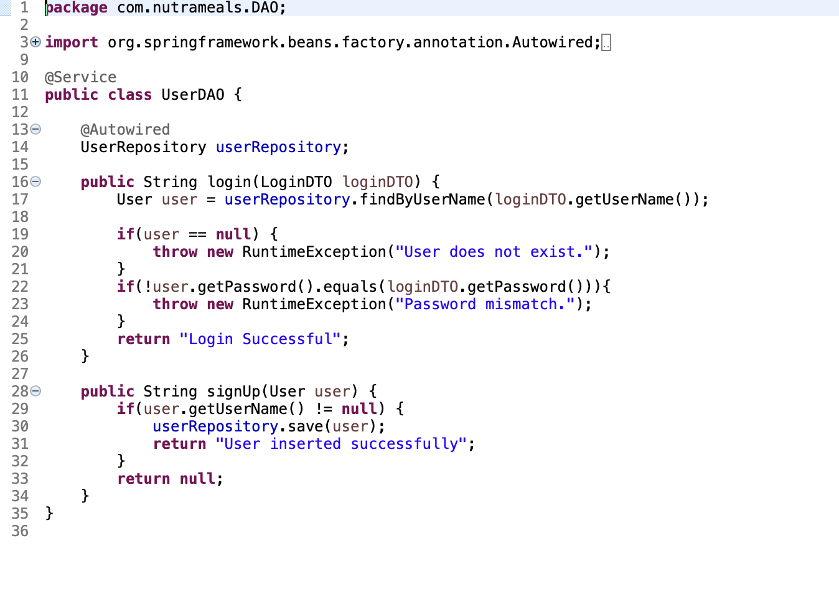
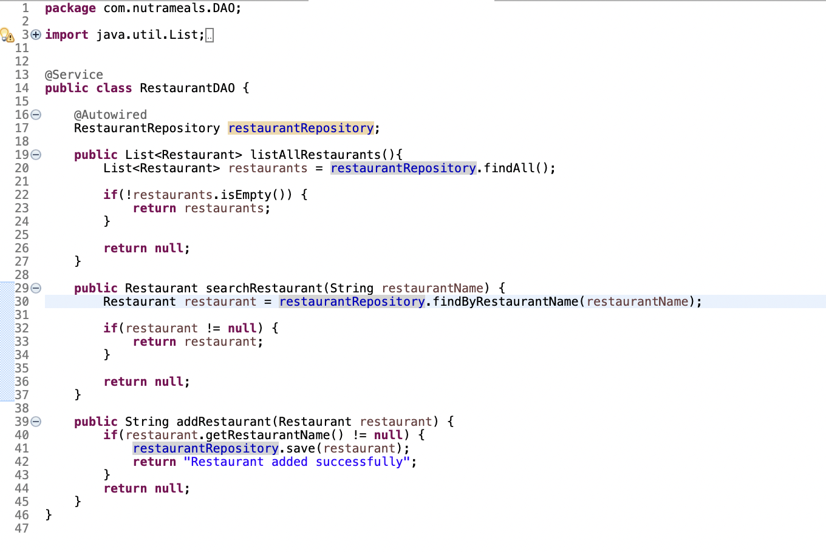
Source code sample (Presenter:- Nikita Jarile)

Slide 19
GitHub repository slides

Slide 20
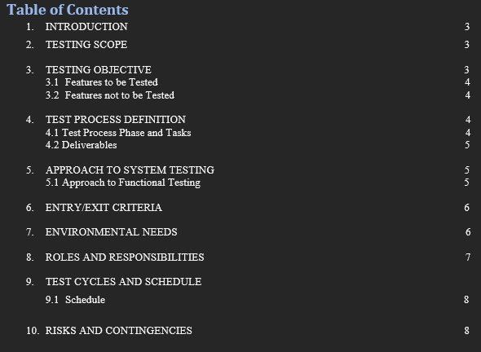
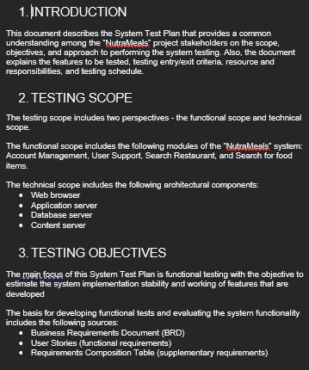
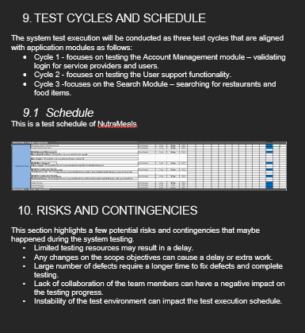
Test Plan Document (Presenter:- Divya Kotapati)

Slide 21

Application Demo

Slide 22
Thank you

